Slide 1

Lecture 12
Math Foundations Team

Slide 2
Introduction
We will look at principle components analysis (PCA) and dimension reduction in this lecture.
High-dimensional data is hard to visulaize and interpret, can we project this data into lower dimensions while preserving the semantics of the data so as to draw the same conclusions as if we interpreted the higher dimensional data?
Higher dimensional data is often overcomplete, in that there are redundant dimensions which can be explained by a combination of other dimensions.
Dimensions in higher-dimensional data might be correlated, so the actual data may have an intrinsic lower-dimensional structure

Slide 3
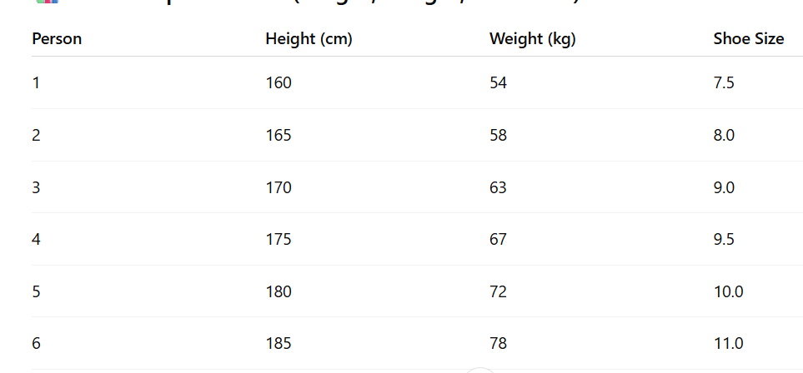
Example for Motivation -
Consider the following data of students:

Slide 4
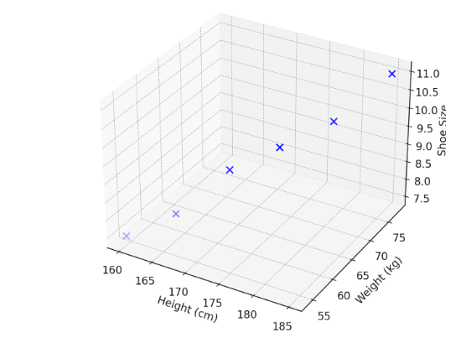
Motivation
We ask the question: “These three features are correlated — can we reduce this to a smaller number of dimensions and still get a sense of the variation between people?”
That is we want dimensionality reduction with minimal information loss (maximum variance).
If we plot these points in 3-dimension space we get
In the next slides we give 2-dim PCA projections on the first two principal components.
We are going to see the theory behind this.

Slide 5
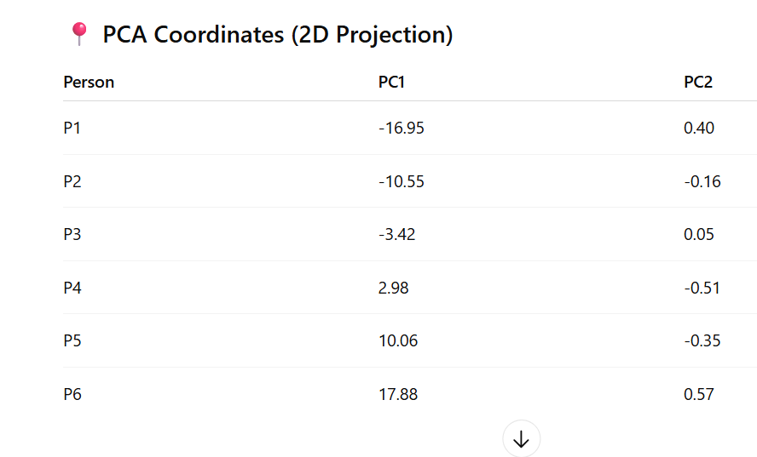
2-dim PCA Projection

Slide 6
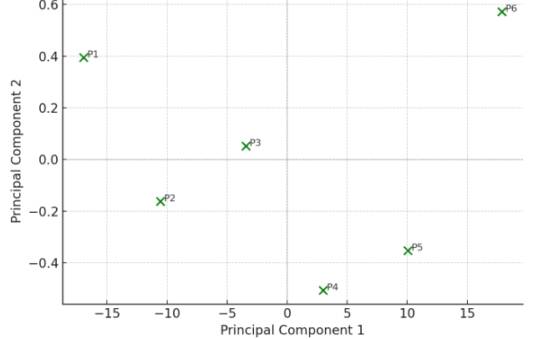
2-dim PCA Projection
Direction along the 2nd Max variance
Direction along the Maximum Variance

Slide 7
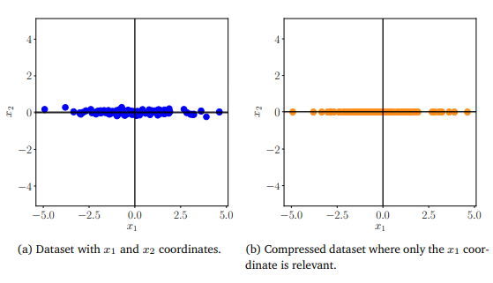
Principle components analysis(PCA)
PCA is a technique for linear dimensionality reduction. It was first proposed by Pearson in 1900 and was independently rediscovered by Hotelling in 1933.

Slide 8
Problem setting
Given : Let {x₁, x₂, . . . , x_{N} }, each x_{i} ∈ R^{D} an independent, identically distributed dataset, with mean 0.
►
Thus, the data covariance matrix S =
1 n=N
N n=1
T
Σ
x x .
n
n
Aim : To find projections x˜_{n} ∈ U ⊆ R^{D} of datapoints x_{n} ∈ R^{D} which are as similar as possible to the original datapoints but dim(U) = M < D.
We are looking for a lower-dimensional compressed representation z_{n} of x_{n} such that z_{n} = B^{T} x_{n} where the projection matrix B = [b₁, . . . , b_{m}] ∈ R^{D×M} .
The columns of B are orthonormal which means b^{T} b_{j} = 0
i
when i ̸= j and b^{T} b_{i} = 1.
i

Slide 9
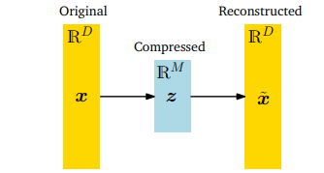
Problem setting
The figure below shows how z represents the
lower-dimensional representation of the compressed data x˜ and plays the role of a bottleneck which controls the information flow between x and x˜.
There exists a linear relationship between the original data x , its low-dimensional code z and the compressed data x˜:
z = B^{T} x , and x˜ = Bz for a suitable matrix B.

Slide 10
Maximum variance perspective
We can interpret information content in the data as how ”space-filling” it is and describe the information contained in the data by looking at the spread of the data.
We can capture spread of the data using the concept of variance.
PCA can then be viewed as a dimensionality reduction algorithm that maximizes the variance in the low-dimensional representation of the data to retain as much information as possible.
Mathematically our aim is to find a matrix B so that we can retain as much information as possible by projecting the data on the columns b₁, b₂, . . . b_{M} of the matrix.

Slide 11
Centred data
If µ is the mean of the data. Centred data means that we work with data columns x − µ, rather than the original columns x .
Note that
V_{z} (z ) = V_{x} (B^{T} (x − µ)) = V_{x} (B^{T} x − B^{T} µ) = V_{x} (B^{T} x ).
Thus by considering x − µ, the variance does not change. Therefore we assume that the data has a mean of 0 for this lecture.
Letting the mean be E_{x} (x ) = 0 means
E_{z} (z ) = E_{x} (B^{T} x ) = B^{T} E_{x} (x ) = 0
►
And the data covariance matrix S =
1 n=N
N n=1
T
Σ
x x .
n
n

Slide 12
Direction with maximal variance
We maximize the variance of the low-dimensional code by following a sequential approach.
Aim 1 : To maximize the variance V₁ of the first coordinate
z_{1n} of z ∈ R^{M}
►
1 n=N
N n=1 1n
i.e to maximize V = V(z ) =
2
1 1
Σ
z since the data x is
independent.
Now z_{1n} = b^{T} x_{n}, and can be viewed as the orthogonal
1
projection of x_{n} onto the one-dimensional subspace spanned
by b₁.

Slide 13

Direction with maximal variance
1
N
1
N
n=N
Then we have V =
T 2
1
Σ
(b x )
1
n
n=1
n=N
=
T
T
Σ
b x x b
1
n n 1
n=1
n=N
= b
T
$\frac{1}{N}$
T
Σ
x x b
1
n
n
1
n=1
= b^{T} Sb₁.
1
Arbitrarily increasing the magnitude of the vector b₁ will increase the variance - so we seek to maximize the variance subject to
b₁ = 1.

Slide 14
Direction with maximal variance
Therefore to find the direction b₁ that maximizes variance can be set up as a constrained optimization problem
max b^{T} Sb₁ subject to
1
b₁ = 1
To solve this problem we set up the Lagrangian
L(x , λ) = b^{T} Sb₁ + λ(1 − b₁ ^{T} b₁).
1

Slide 15
Solving the Lagrangian
To solve the Lagrangian, let ^{∂L} = 0 and ^{∂L} = 0.
∂λ ∂b1
So, we get
∂L
∂λ
∂L
∂b₁
= 1 − b^{T} b = 0
1
1
= 2b^{T} S − 2λb^{T} = 0
1 1
On simplification, we have Sb₁ = λb₁ and b^{T} b₁ = 1.
1
Thus we find that the direction b₁ we seek is an eigenvector of the covariance matrix S and λ is its corresponding eigenvalue.

Slide 16
First principal component
Putting the result of the previous slide into the objective function of the constrained optimization problem ie. max b^{T} Sb₁ we have b^{T} Sb₁ = b^{T} λb₁ = λ.
1 1 1
Our objective function boils to maximizing λ which means we are looking for the eigenvector of S that corresponds to its largest eigenvalue.
This is the first principal component.
Let us now examine the inner workings of the Lagrangian method.

Slide 17
M-dimensional subspace with maximum variance
Assume that we have found the first m − 1 principal components as the m − 1 eigenvectors of S that are associated with the largest m − 1 eigenvalues of S .
Since S is symmetric we can use the spectral theorem to use the m − 1 eigenvectors to construct an orthonormal basis of an m − 1-dimensional basis of a subspace of R^{D} .
The mth principal component can be found by subtracting from the data the contribution of the first m − 1 components b₁, b₂, . . . b_{m−1}. Essentially we are trying to find principal components that compress the remainder of the information.

Slide 18
M-dimensional subspace with maximum variance
X = [x₁, x₂, . . . , x_{N} ] ∈ R^{D×N} contains the data points x_{k} as column vectors.
Then, new data matrix X^{ˆ} is given by
m−1
_{X}ˆ
T
= X − b b X
Σ
i i
i =1
= X − B_{m−1}X
►
Here B =
m−1
T
m−1
Σ
b b is a projection matrix that projects
i
i =1 i
X onto the subspace spanned by b₁, b₂, . . . b_{m−1}.

Slide 19
M-dimensional subspace with maximum variance
To find the mth principal component we maximize
1
N
1
N
n=N
V_{m} = V[z_{m}] =
Σ
z
2
mn
n=1
n=N
=
T
2
Σ
(b x
ˆ )
m n
n=1
= b^{T} S^{ˆ}b_{m}.
m
Here S^{ˆ} is the data covariance matrix of the transformed data set represented by xˆ = [xˆ₁, xˆ₂, . . . xˆ_{N} ].

Slide 20
M-dimensional subspace with maximum variance
As before we set up a constrained optimization problem to find the first principal component, and establish that the optimal solution b_{m} is the eignevector of S^{ˆ} that corresponds to the largest eigenvalue.
We now establish that b_{m} is an eigenvector of the original data matrix X .
More generally the sets of eigenvectors for S^{ˆ} and S are the same.

Slide 21
Eigenvectors of S and S^{ˆ}
We now show that the eigenvectors of S and S^{ˆ} are the same.
Let b_{i} be an eigenvector of S, i.e Sb_{i} = λb_{i} .
Now we can write
S^{ˆb} = ¹ (X − B X )(X − B X )^{T} b
i m−1
m−1 i
N
= (S − SB^{T}
— B_{m−1}S + B_{m−1}SB^{T} )b_{i}
m−1 m−1
= (S − SB_{m−1} − B_{m−1}S + B_{m−1}SB_{m−1})b_{i}
Note that in the last line we have used the fact that B_{m−1} is a projection matrix and is therefore symmetric.

Slide 22
Eigenvectors of S and S^{ˆ}
Case 1: i ≥ m.
b_{i} is an eigenvector not among the first m − 1 components.
►
Since B =
m−1
T
m−1
Σ
b b and b is orthogonal to the
i =1 i
i m
b_{i}, 1 ≤ i ≤ m − 1, we have B_{m−1}b_{i} = 0.
Plugging this into the last equation on the previous slide, we see that S^{ˆ}b_{i} = (S − B_{m−1}S)b_{i} = Sb_{i} = λ_{i} b_{i} .
Thus Sb_{m} = λ_{m}b_{m}. λ_{m} is the mth largest eigenvalue of S and is also the largest eigenvalue of S^{ˆ} because of the way the constrained optimization problem is set up.

Slide 23
Eigenvectors of S and S^{ˆ}
Case 2: i ≤ m − 1.
►
We have B b =
m−1
T
m−1 i
Σ
b b b = b .
j=1 j
j i i
Plugging this into
S^{ˆ}b_{i} = (S − SB_{m−1} − B_{m−1}S + B_{m−1}SB_{m−1})b_{i} , we get
Sb_{i} = 0.
Thus the vectors b₁, b₂, . . . b_{m−1} are eigenvectors for S^{ˆ} which are associated with the eigenvalue 0.

Slide 24
Since V_{m} = b^{T} Sb_{m} = λ_{m}, we see that the variance of the
m
data projected onto the mth principal component is λ_{m}.
To find an M-dimensional susbspace that retains as much information as possible, PCA tells us to choose the columns of the matrix B as the M eigenvectors of the data covariance matrix S that have the largest eigenvalues.

Slide 25
Projection perspective
We derived the PCA as an algorithm that maximizes the variance in the projected space to retain as much information as possible.
Now we can also derive the PCA using a projection perspective to minimize the average reconstruction error. The original data is modeled as x_{n} and the reconstruction is modeled as x˜_{n}. We seek to minimize the distance between x_{n} and x_{n}.

Slide 26

An Example
Consider the data given below:
x1 | x2 | x3 | x4 | x5 | x6 | x7 | x8 | x9 | Mean
1.11 | 1.21 | 1.36 | 1.49 | 1.63 | 1.68 | 1.83 | 1.88 | 1.95 | 1.571111111
10 | 12 | 13 | 15 | 16 | 17 | 18 | 19 | 20 | 15.55555556
$$\frac{1}{9}XX^{T}=$$

Slide 27
Hence the Data Covariance Matrix
1
S = XX^{T}
9
0.079498765 0.888271605
0.888271605 10.02469136
=
The largest eigenvalue of S is 10.103 and the corresponding eigenvector with unit norm (first principal component ) is b₁ = [0.088269, 0.996097]^{T} .

Slide 28
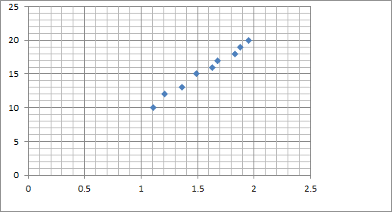
An Example
Data when plotted, we get

Slide 29
The compressed or the reduced data is then given by z = b^{T} X
1
z1 | z2 | z3 | z4 | z5 | z6 | z7 | z8 | z9
-5.57 | -3.57 | -2.56 | -0.56 | 0.45 | 1.45 | 2.46 | 3.46 | 4.46
We can project the data onto the principal subspace by X˜ = b₁z . To obtain our projection in the original data space (i.e., before standardization), we need to undo the standardization.
X˜ = X˜ + µ

Slide 30
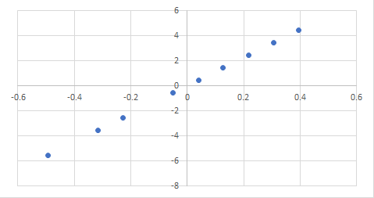
Projected data onto the Principal Subspace

Slide 31
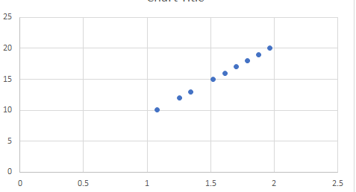
Projected data onto the Principal Subspace in the original data space

